Slide 1
Lecture 15
Second-order Circuits (3)
Hung-yi Lee

Slide 2

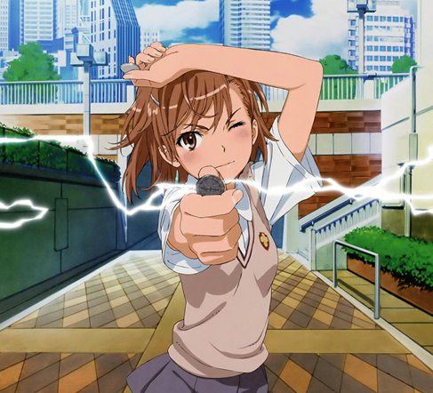

Slide 3
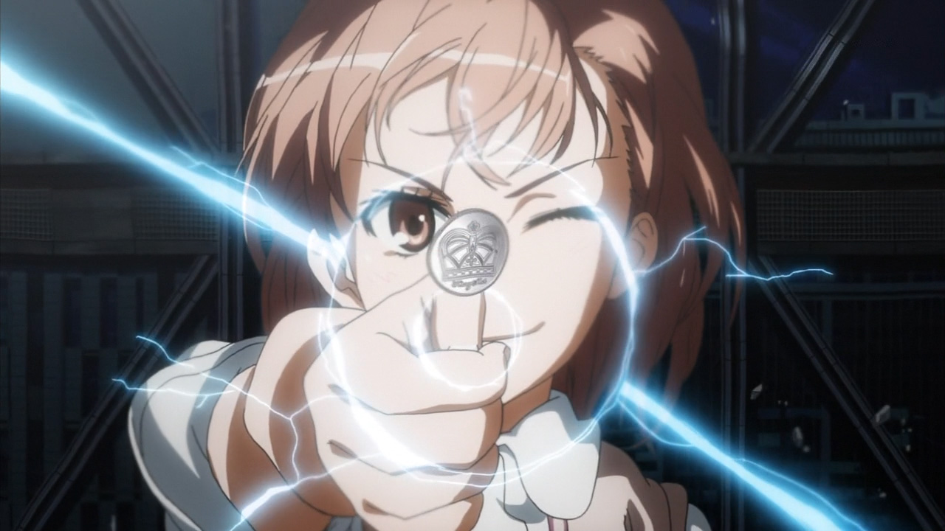
Rail gun
Transforming electric energy into kinetic energy

Slide 4

Demo – Misaka

Slide 5

Demo – U.S. Navy

Slide 6
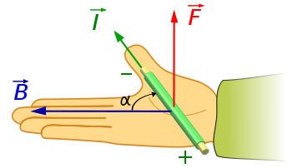
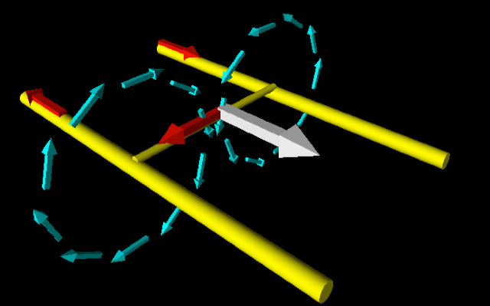
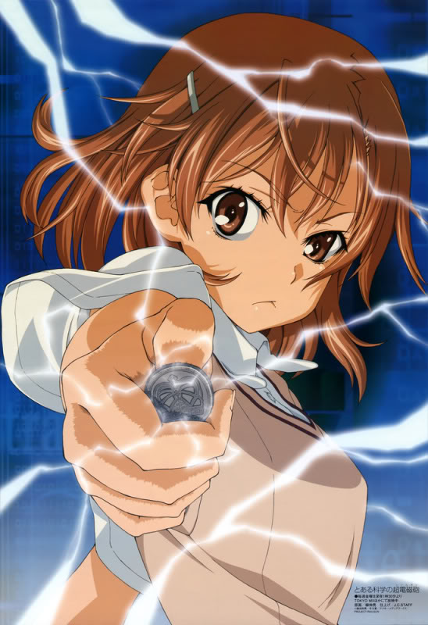
Lorentz force
Red: current
Blue: Magnetic Field
While: Force
?
Notes:
Also consider the length of the rail gun

Slide 7
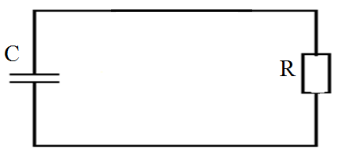
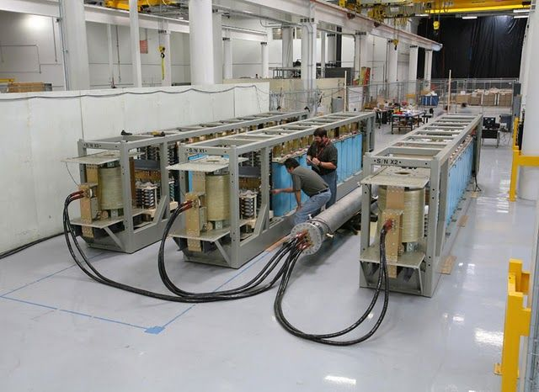
Store Energy in Capacitor
projectile
Fire at t=0
Rail gun capacitor banks constructed at a General Atomics facility in San Diego

Slide 8
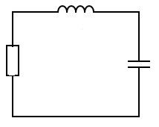
Second Order Circuit

Slide 9
Second Order Circuit

Slide 10
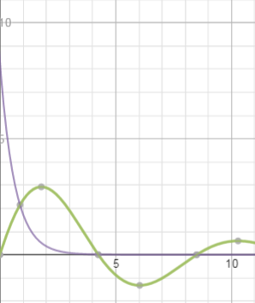
First order:
Second order:

Slide 11
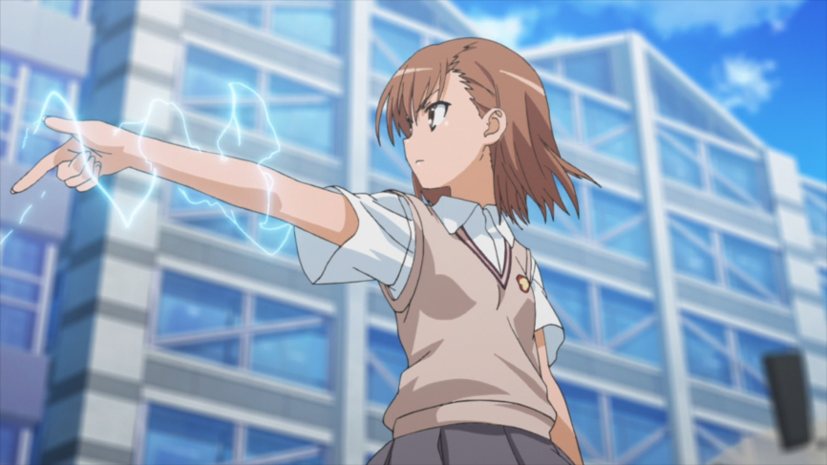
Finally …

Slide 12
Reference – Not related to Misaka
PowerLabs Rail Gun Research!
  http://www.powerlabs.org/railgun.htm
Principles of Electric Circuits: Part 2
  https://www.youtube.com/watch?v=ZeWfZP5D8Dw

Slide 13
Reference - Related to Misaka
科漫人-超電磁砲科學嗎?
  http://home.gamer.com.tw/creationDetail.php?sn=1199686
空想科學中的超電磁砲（RAILGUN）探討
  http://www.shs.edu.tw/works/essay/2011/11/2011110217484365.pdf
日本技術宅自製電磁炮
  https://www.youtube.com/watch?v=Ab1qDnWog-8
  背景音樂支援
    https://www.youtube.com/watch?v=DtLp1ffvcyU
    https://www.youtube.com/watch?v=9cYdjkq0rtI

Slide 14
Appendix:
Automobile Ignition System
http://www.me.utexas.edu/~longoria/me383Q/notes/4_Rizzoni_Ex_5.17_ignition_circuit.pdf

Slide 15
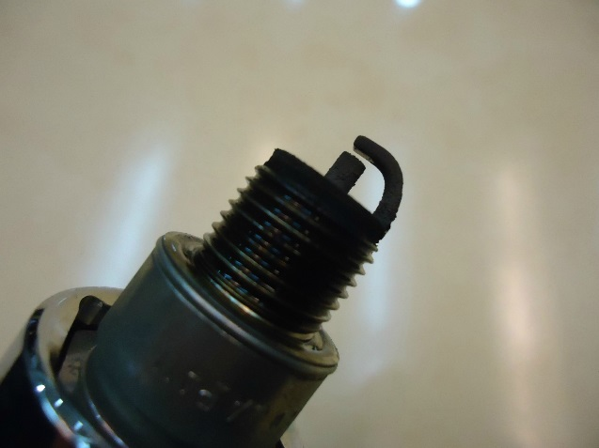
Automobile Ignition System
12V

Slide 16
Automobile Ignition System

Slide 17
Appendix:
Airbag Igniter

Slide 18
Dorf P1271

Slide 19
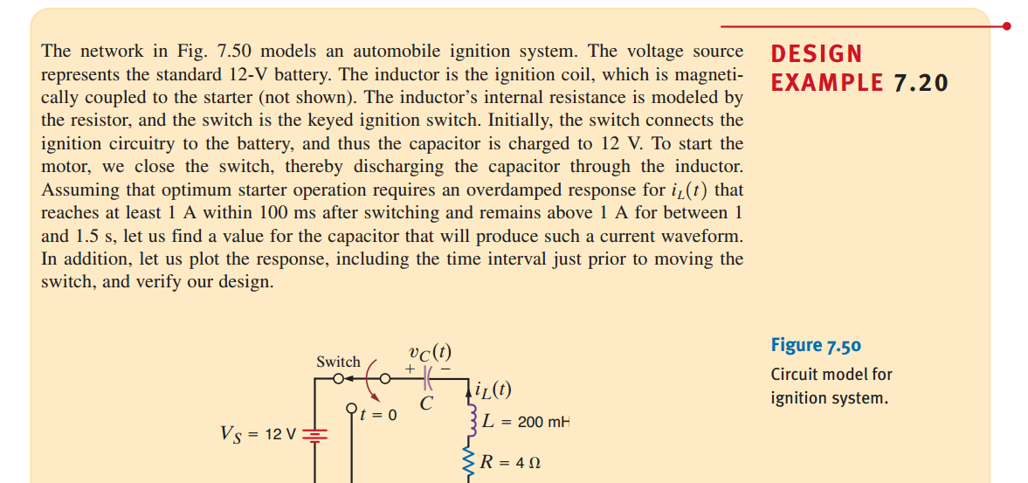

Slide 20
Appendix:
Heart Pacemaker

Slide 21
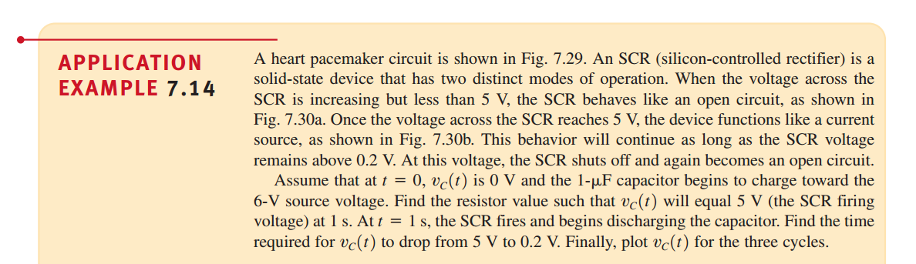
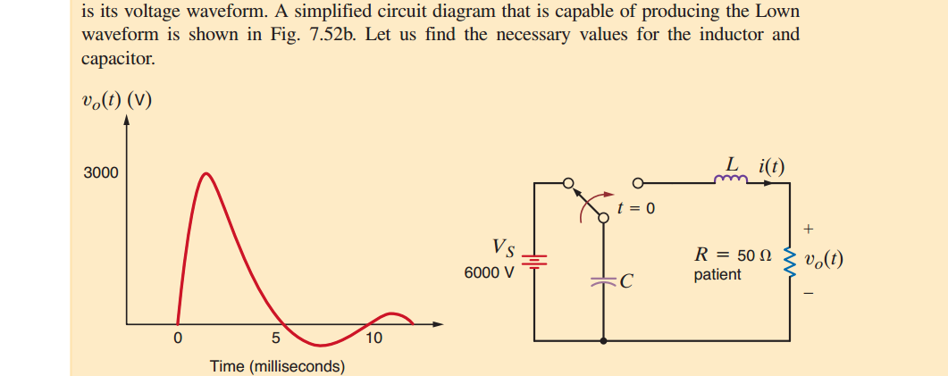

Slide 22
Appendix:
Misaka

Slide 23
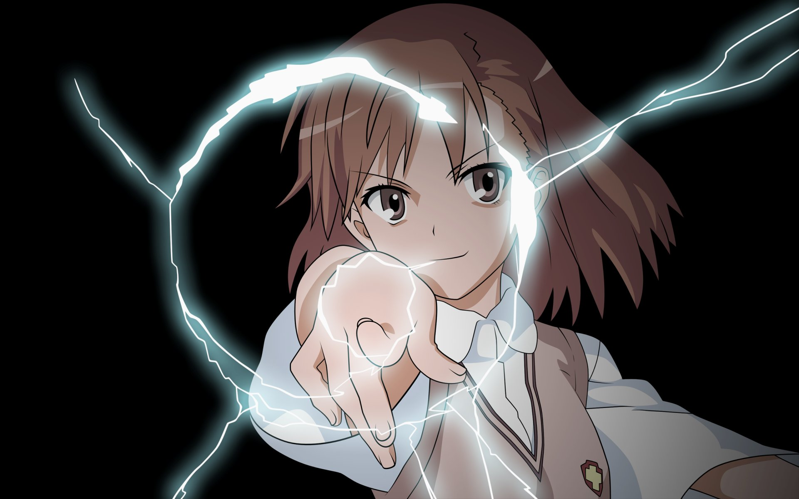

Slide 24
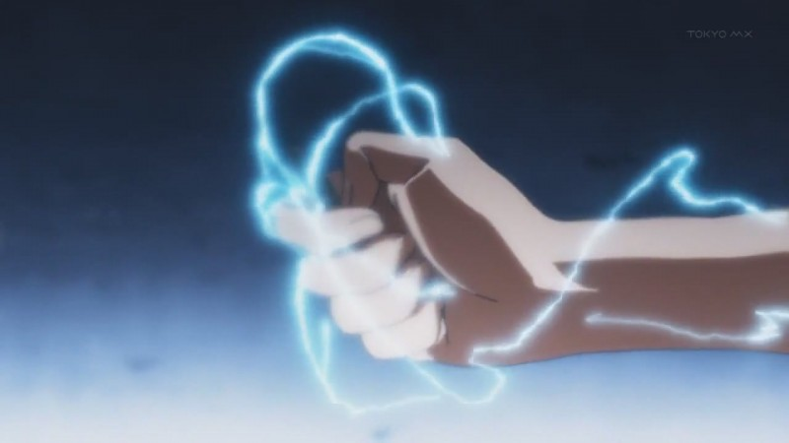

Slide 25


Slide 26
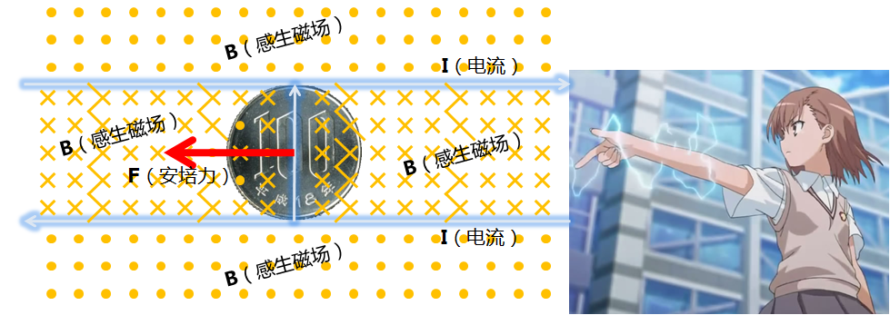
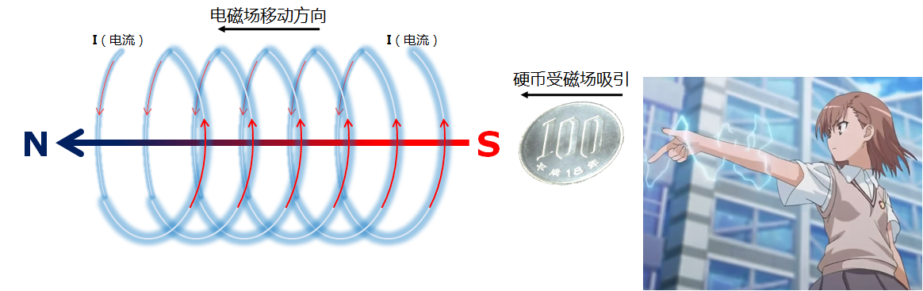
Notes:
http://www.twwiki.com/wiki/%E8%B6%85%E9%9B%BB%E7%A3%81%E7%82%AE

